Slide 1

RIO-AI Voice Assistant
Made by:
Vikhyat Jalota(20BCS6696)
Abhishek Verma(20BCS6707)
CLASS: AIML-3B

Slide 2
Aim: A voice recognition software that acts as an assistant.
Modules Used:
Software Used:
Microsoft VS Code
Language:
Python
Library used for GUI:
Tkinder
Pyttsx3
datetime
speech_recognition Wikipedia
webbrowser
Os
Image,ImageTk

Slide 3
A smart assistant for your daily needs
AI Voice Assistant has many amazing features, using “Speech to Speech” it recognises anything you say.
Some of those exceptional features are
*It greets you when you boot it up
*It can open Apps like Youtube, Chrome, Spotify etc. just by listening to you.
*You can even ask it to navigate around your PC files and applications
*Don’t know anything about something? This Smart Assistant will tell you everything you might want to know

Slide 4
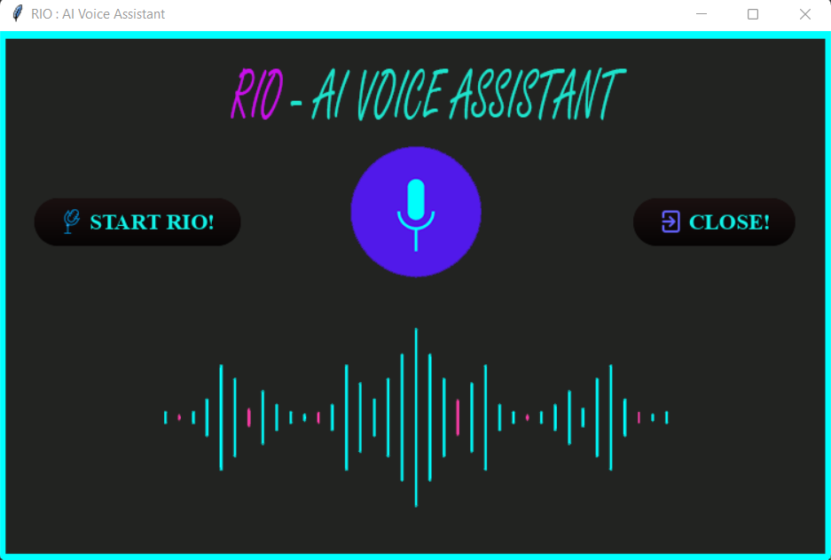
Here’s our GUI for this program
It is simple, effective, and fits right for our program.

Slide 5
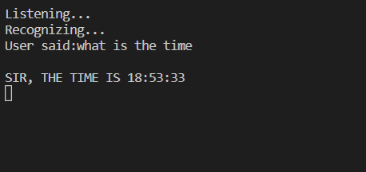
Time to flex some of its features
It Speaks the time for you and even displays it if you want to hear its voice, just ask!

Slide 6
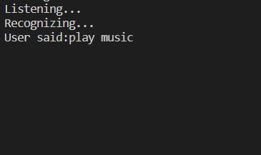
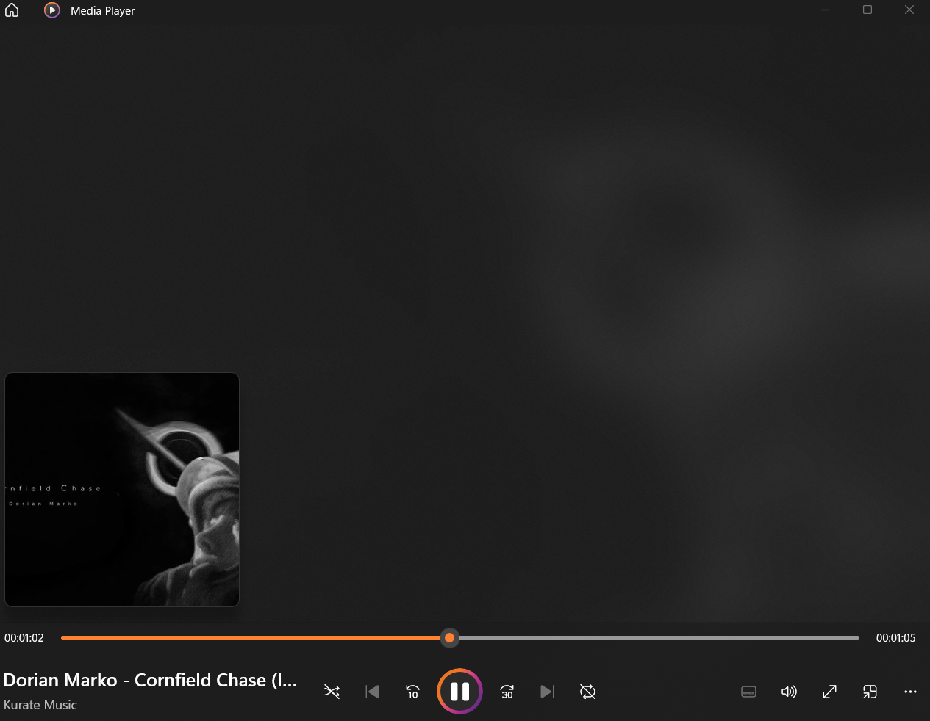
Want to hear songs ? RIO will play it for you!

Slide 7
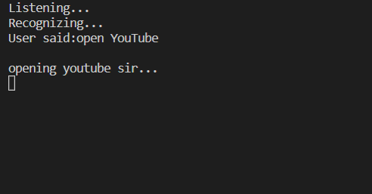
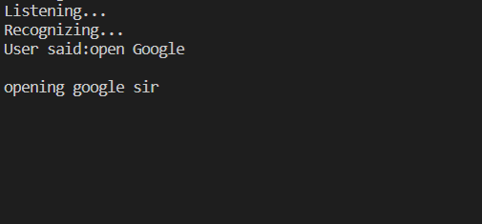
Want to surf the web? rio got your back
Opening Youtube by saying command “Open Youtube”
Opening Google with ease

Slide 8
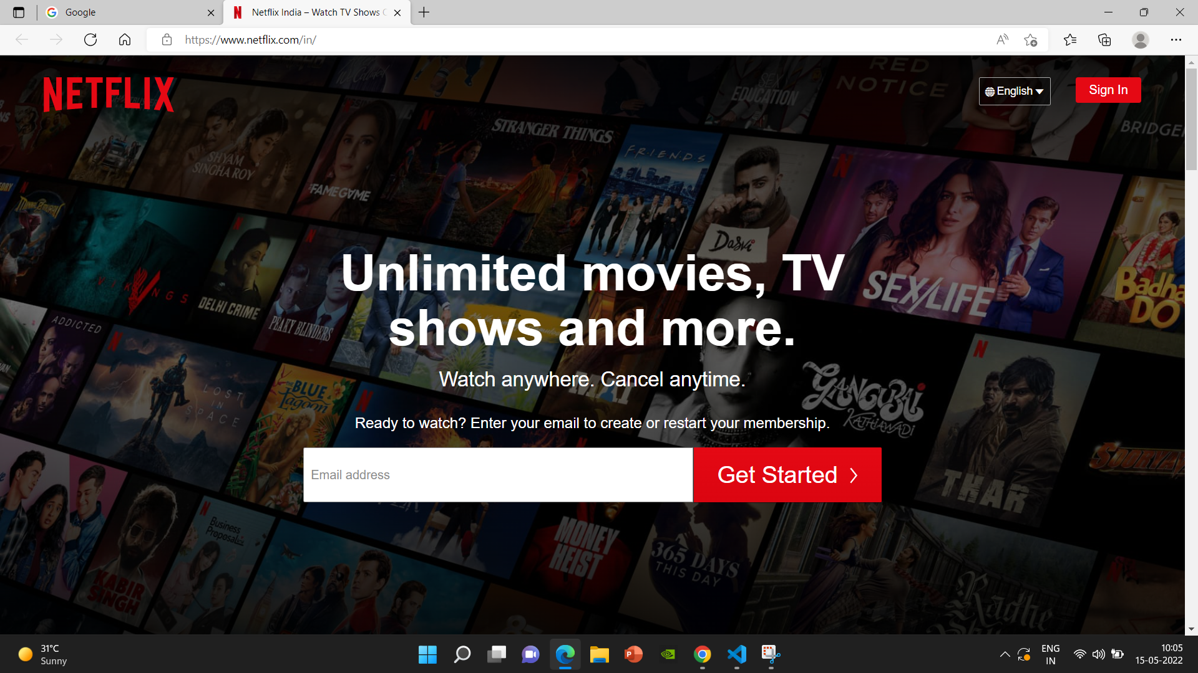
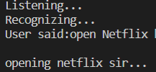

It has Netflix at its fingertips!
Much more features are implemented in RIO!!

Slide 9
How will this BE BENEFICIAL FOR THE SOCIETY
A speech recognition software can:
1. Help people with special needs
2. The user can easily multitask using this software
3. People who cannot interact with keyboard can use this software to use their computer

Slide 10
Thankyou for watching this ppt, reviews and suggestions are much appreciated.

